Slide 1
we say

Slide 2
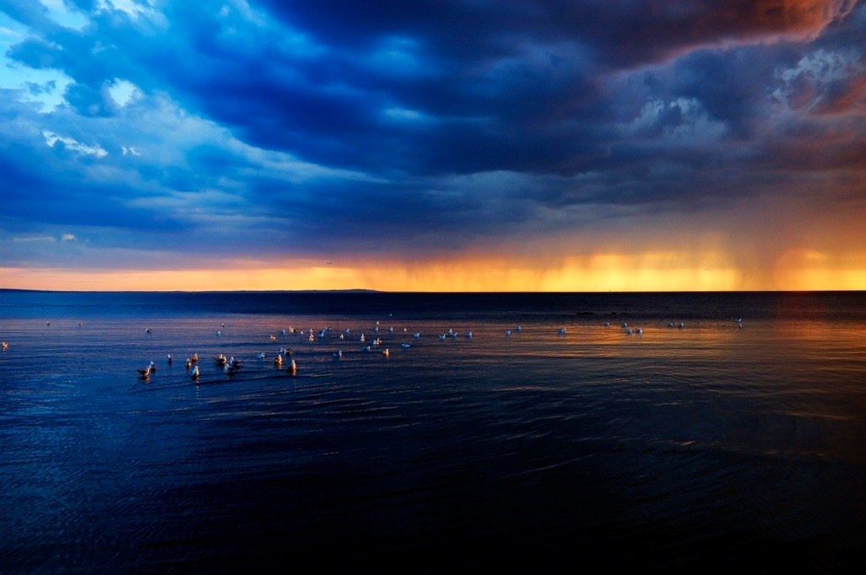
we say
God created the universe

Slide 3
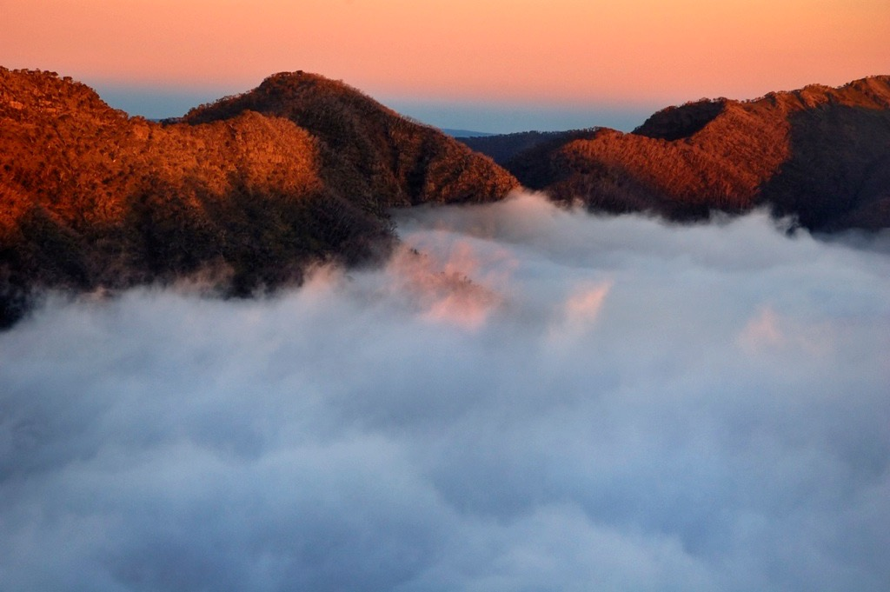
and the world we live in

Slide 4
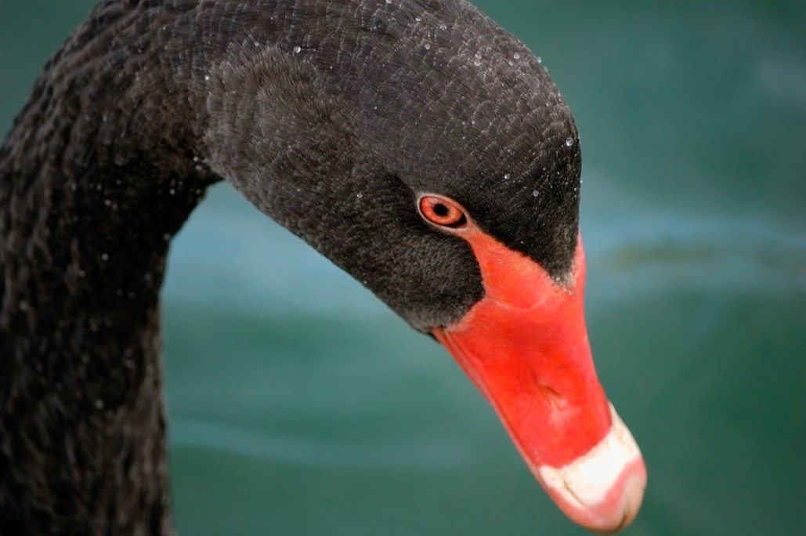
and every living thing
on this earth

Slide 5
we believe

Slide 6
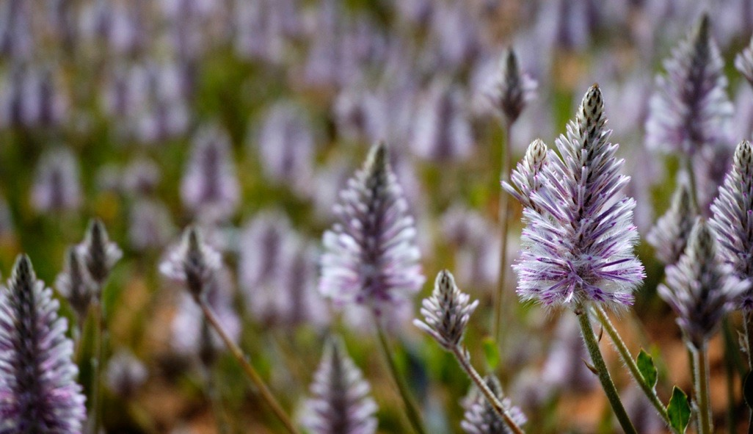
we believe
the Creation shows us
the power and presence of God

Slide 7
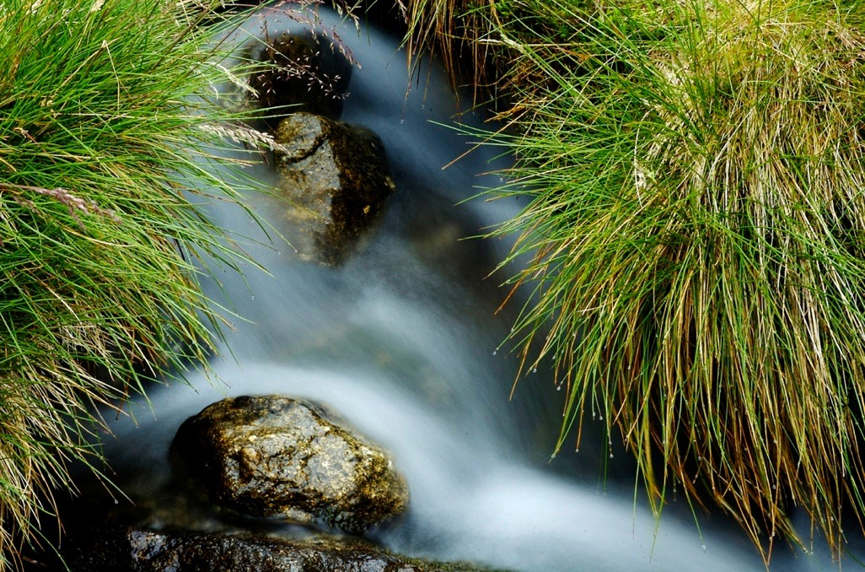
and makes us
want to praise
and give thanks to God

Slide 8
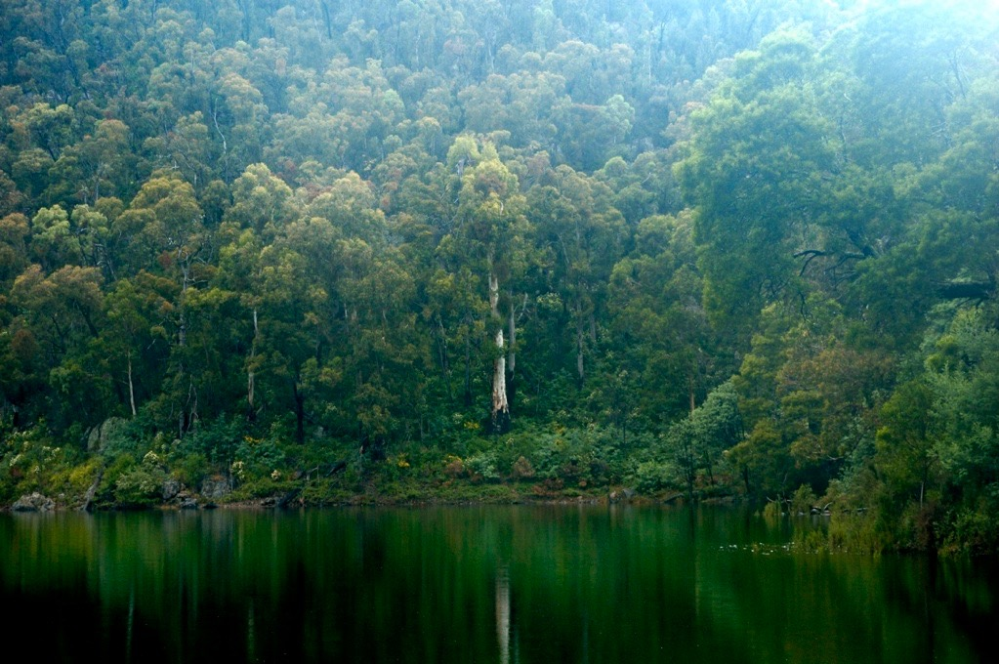
and take good care of the earth God has made

Slide 9
we are full of joy

Slide 10
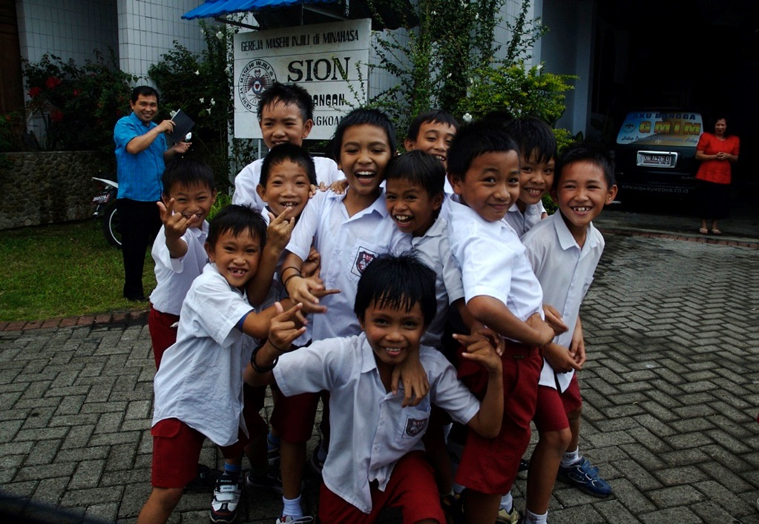
we are full of joy
that across the world
different peoples have their own
culture and language

Slide 11
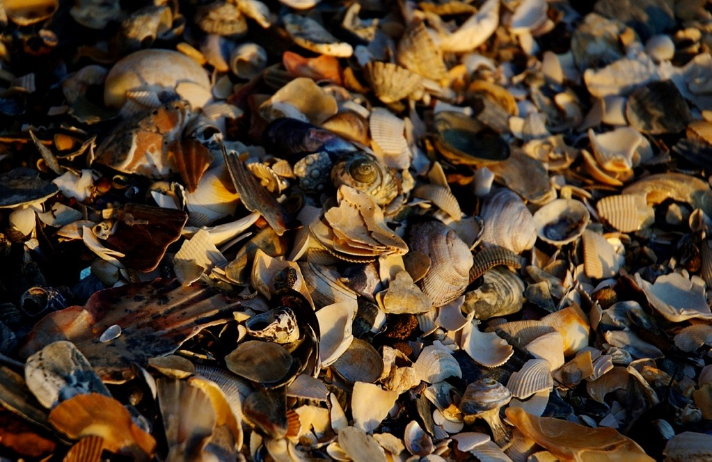
and that in God
we are all united
together as one

Slide 12
we say

Slide 13
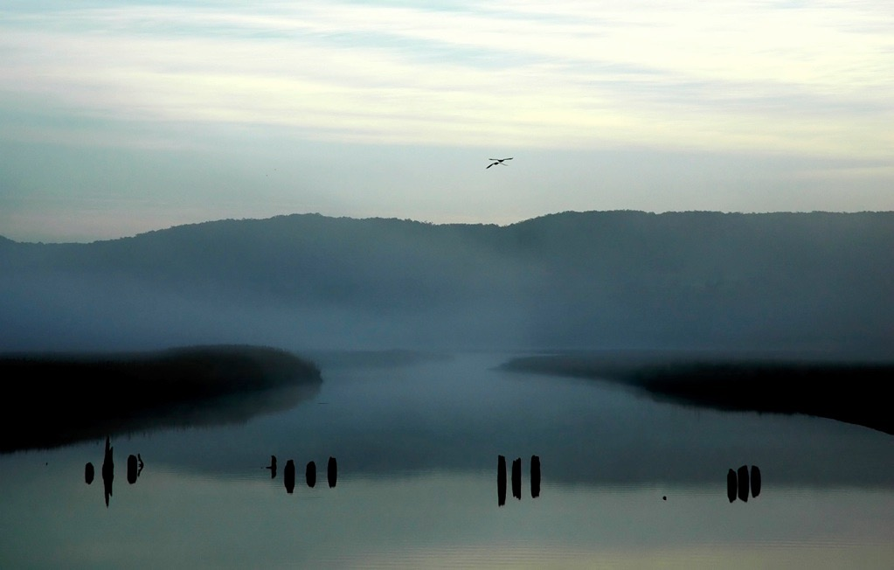
we say
God is Spirit
breath of life

Slide 14
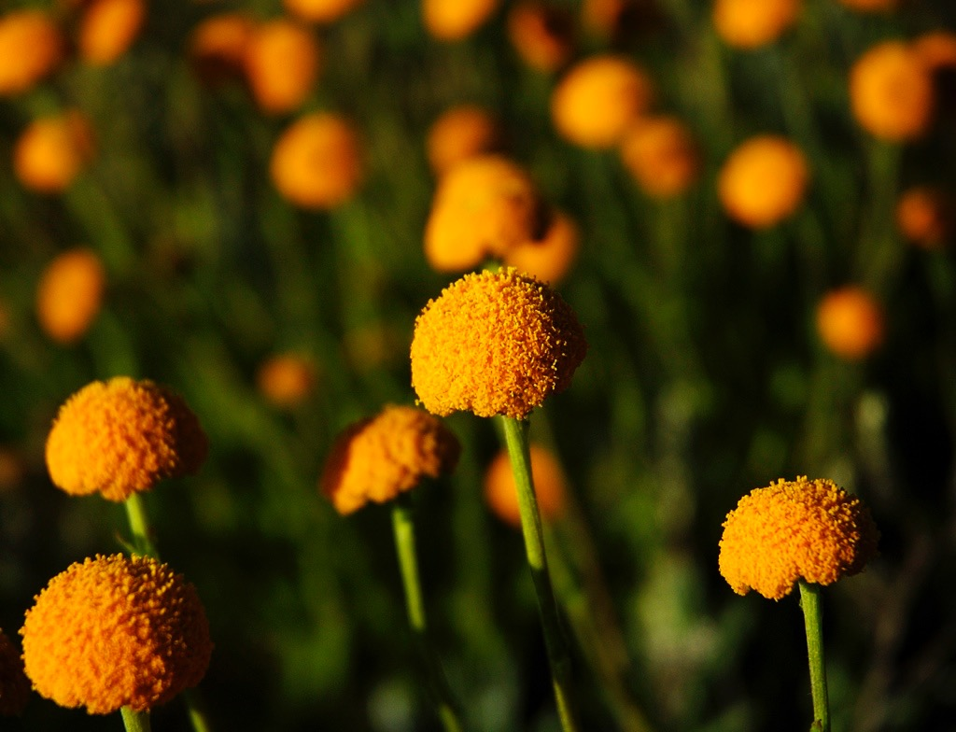
who is always working
to bring people to life
in God

Slide 15
we believe

Slide 16
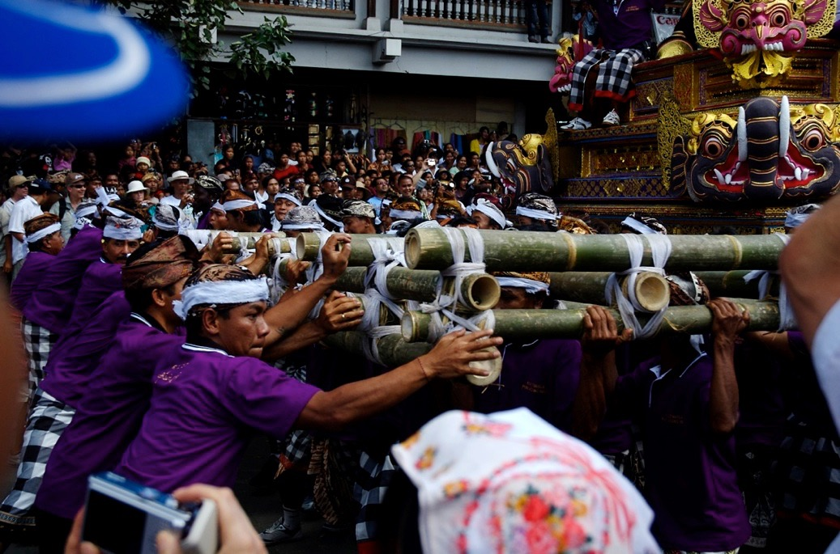
we believe
the Spirit has been alive and active
in every race and culture

Slide 17
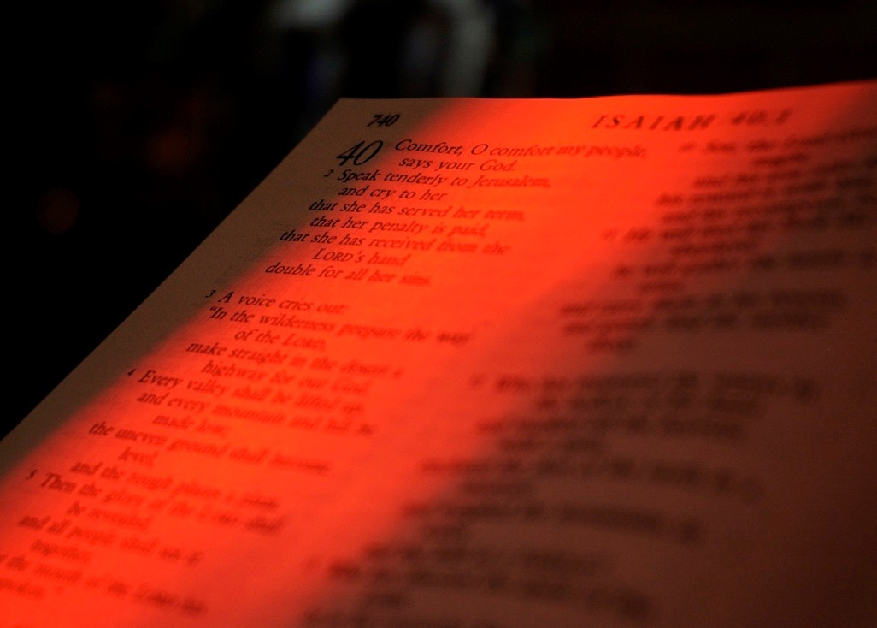
getting hearts
and minds
ready for
good news

Slide 18
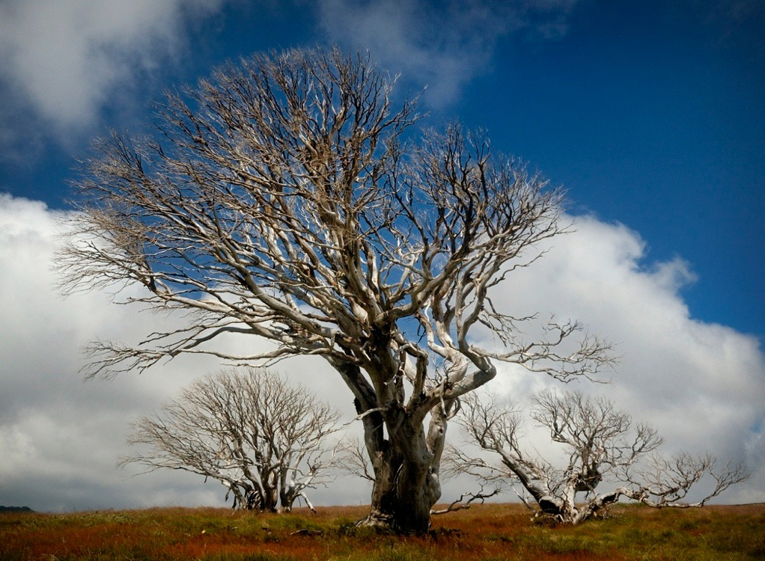
the good news of
God’s love and grace
that Jesus Christ
revealed

Slide 19
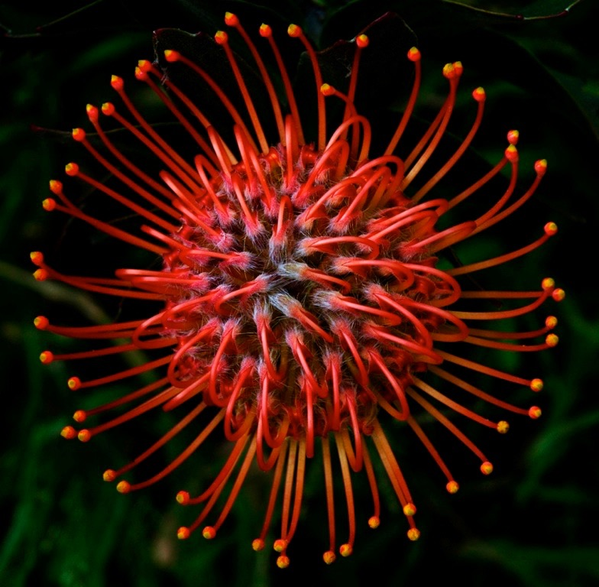
that Jesus Christ
revealed

Slide 20
Photos by

