Slide 2
A Referendum for an Aboriginal and Torres Strait Islander Voice to Parliament
A Resource from the Uniting Church Assembly

Slide 3
This year, we will have the opportunity to vote on whether we should recognise Aboriginal and Torres Strait Islanders in our constitution.
We will be asked whether to make that important symbolic action by supporting an Indigenous “Voice” to Parliament.
This is the first of three things called for by the Uluru Statement from the Heart — an invitation from First Nations people to all Australians to help build a better future. It is a vital first step to enabling Treaty and Truth-telling.
Voice. Treaty. Truth.

Slide 4
Why is it needed?
Symbolic recognition of First Peoples in our country’s foundational document. “In 1967, we were counted. In 2017, we seek to be heard” (Uluru Statement from the Heart).
Since 1967 five different legislated forums for Indigenous voices to be heard have been created and disbanded. Putting it in the Constitution provides for longevity.
There is a great need for well-informed, practical solutions to overcoming disadvantage. Hearing First Peoples’ voices is key to this.
A Voice is needed as a pathway to Treaty and Truth-telling for which the Uluru Statement calls.

Slide 5
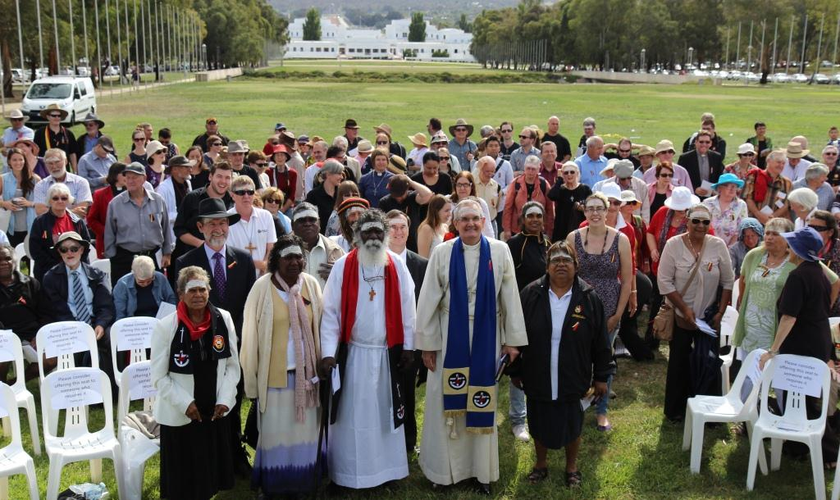
Why Does the UCA Support the Voice?

Slide 6
The UCA took up the invitation of the UAICC to enter into Covenant. Informed by this Covenant, and having heard from UAICC, we see that the Invitation of the Uluru Statement to Australia is similarly an opportunity for a step into a future of justice and reconciliation.
We believe that all people are created in the image of God and should be respected, included and supported in society. Where this has not happened, we are called to right wrongs of the past and work for reconciliation.
Our UCA revised Constitutional Preamble says something about who we are, and who we hope to be, and we believe that this referendum gives us a similar opportunity to say something about who we are as a nation.
The Preamble recognises our need to listen to the unique insights of First Peoples into God’s ways, and the Voice to Parliament similarly enables our nation to listen to and learn from the voices of First Peoples.

Slide 7
What can I do?
Find Out More
(Get the Handout)
Read the Statement from the Heart
Start a Conversation about the Voice
Find Out Even More
(Uniting.Church/Voice)

Slide 8
Prayer
Let’s take some time to pray for First Peoples and for our nation as a whole as we think about this period of ongoing national discussion, the process of the referendum and the outcomes that flow from it

