Slide 1
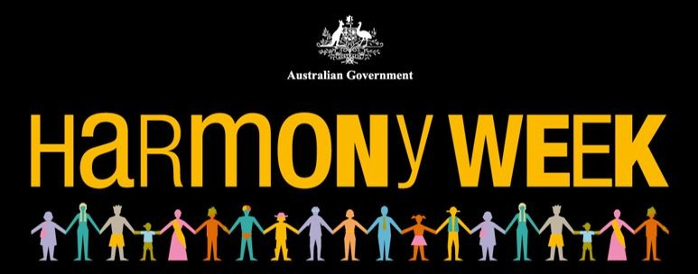
Prayer Service for International Day for the Elimination of Racial Discrimination
Notes:
Harmony Day in Australia is also the International Day against Racial Discrimination. As these days overlap, we remember that we cannot have peace until we concretely address and reject racism, discrimination and intolerance in every form and place – including the church.

Slide 2
Acknowledgement of Country
Notes:
We acknowledge this land that we meet on today is the traditional lands for the Kaurna people and that we respect their spiritual relationship with their country.
We also acknowledge the Kaurna people as the custodians of the Adelaide region and that their cultural and heritage beliefs are still as important to the living Kaurna people today.
We also pay respects to the cultural authority of Aboriginal people visiting/attending from other areas of South Australia/Australia.

Slide 3
Invitation
Come, all of you who have been ostracised and marginalised.
Come, all of you who have been indifferent in the face of racial injustice.
Come, all of you who have prophetically challenged racism.
Come, all of you who have perpetrated acts of racial injustice.
Come all and receive rest for your weary souls.
Come to the fountain of life and receive grace upon grace.

Slide 4
Invitation
Triune God,
in whom we see the perfect interpersonal relation of love as Father, Son and Holy Spirit, we come responding to your love and rejoicing knowing as we come to you,
none will be turned away.

Slide 5
Song
Notes:
“God welcomes all, strangers and friends” very short song from the Iona Community, originally from South Africa

Slide 6
Opening Prayer
Together
God of all,
Triune God,
you are the source of perfect love.
…
Amen.
Notes:
As we observe the International Day for the Elimination of Racial Discrimination,
we recognize you to be God,
who created all people fashioning us in your own image and likeness.
As we give thanks for the wonder and beauty of the works of your hands,
we also lament
the many ways in which we seek to injure and tarnish each other as your creation.
Might we on this day hear again the truth of your Word
as we are confronted with the question:
“Have we not all one father? Has not one God created us?
Why then are we faithless to one another?”
As we pray together may your Spirit of truth refresh and renew us!
Fill us, we pray with your light, grace and strength.
Delight our minds with wholesome life-giving thoughts one toward the other.
As we work towards eliminating racial discrimination, unite our tongues, renew our hearts.
We pray in the name of the One in whom there is no longer Jew or Greek,
slave or free, male and female, Jesus, the Christ.

Slide 7
Psalm 4
Answer me when I call, O God of my right!
You gave me room when I was in distress.
Be gracious to me, and hear my prayer.
Be gracious and hear our cry, O Lord.

Slide 8
Psalm 4
How long, you people, shall my honor suffer shame?
How long will you love vain words, and seek after lies?
Be gracious and hear our cry, O Lord.

Slide 9
Psalm 4
But know that the Lord has set apart the faithful for himself;
the Lord hears when I call to him.
When you are disturbed, do not sin;
ponder it on your beds, and be silent.
Be gracious and hear our cry, O Lord.

Slide 10
Psalm 4
Offer right sacrifices, and put your trust in the Lord.
There are many who say, “O that we might see some good!
Let the light of your face shine on us, O Lord!”
Be gracious and hear our cry, O Lord.

Slide 11
Psalm 4
You have put gladness in my heart
more than when their grain and wine abound.
I will both lie down and sleep in peace;
for you alone, O Lord, make me lie down in safety.
Be gracious and hear our cry, O Lord.

Slide 12
Prayer of Confession
Have mercy O Lord, we pray. Amen.
Notes:
Gracious God, we confess that as human beings, we sometimes miss the beat of your call to holiness and righteousness.
We do not always move in time to your drumbeat of peace with you and with one another. We resist your Holy Spirit’s nudges to follow the new commandment of our Saviour – to love one another.
Instead, we struggle even to tolerate each other and the uniqueness of each human being.
Our faithlessness puts us out of step with your movements of compassion expressed through Christ’s love.
We confess that we have used our distorted voices to speak words that do not edify, but rather destroy.
We trust your grace to restore our lives, our communities, and our world to sweet harmony, especially in these challenging and uncertain times.
As we confess our sinfulness, lead us to repentance so that we will value all human beings as contributing to the orchestra of life’s symphony.

Slide 13
Bible reading: 1 John 3:11-18
11 For this is the message you have heard from the beginning, that we should love one another. 12 We must not be like Cain who was from the evil one and murdered his brother. And why did he murder him? Because his own deeds were evil and his brother’s righteous. 13 Do not be astonished, brothers and sisters, that the world hates you. 14 We know that we have passed from death to life because we love one another. Whoever does not love abides in death. 15 All who hate a brother or sister are murderers, and you know that murderers do not have eternal life abiding in them. 16 We know love by this, that he laid down his life for us—and we ought to lay down our lives for one another. 17 How does God’s love abide in anyone who has the world’s goods and sees a brother or sister in need and yet refuses help? 18 Little children, let us love, not in word or speech, but in truth and action.

Slide 14
Prayers of Thanksgiving and Intercession
Creator God, we bow in humble adoration of your mighty power and constant presence. We celebrate that you have created all races and peoples equally in Your image.
We give you thanks.

Slide 15
Jesus Christ, our Saviour and Lord, we give thanks that in your death on the cross, you redeem all humanity bringing freedom to all who are in any way oppressed.
We give you thanks.
Holy Spirit, we give thanks for the ways in which today you convict us of racial discrimination, injustice and hatred, and make us ministers of reconciliation, building bridges and healing wounds.
We give you thanks.

Slide 16
We are grateful that each day you are enabling us, your people, to recognize their rightful place in your creation. We give thanks for people everywhere who continue the struggle for freedom to those who are continually discriminated against because of their racial identity.
We give you thanks.

Slide 17
We give thanks that in the fight to end racial discrimination, women and men have answered your call to this vocation and have contributed positively to this cause seeking to better the condition of all humanity through their talents, skills and ideas.
We give you thanks.

Slide 18
Gracious God, contrary to your divine plan, racism continues to be pervasive and divisive in this world. In many places, so many people are still considered and treated as an inferior because of the colour of their skin.
We pray that your liberating power will set us free from racism.
Hear, O Lord and have mercy.

Slide 19
Loving God, we currently remember our sisters and brothers throughout the world who suffer under racist structures, legacies of the Doctrine of Discovery and colonialism.
We pray for those who are exploited, manipulated and discriminated against, because of the colour of their skin.
Hear, O Lord and have mercy.

Slide 20
God of the oppressed, we call upon you to transform political and social structures which dehumanize your people. May leaders of all countries be guided by your Holy Spirit
so that all decisions made may be for the common good.
Hear, O Lord and have mercy.

Slide 21
Liberator God, we lift before you those who have suffered a painful history of African slavery. Remove, O God, the scars and mentality of colonialism and imperialism.
Release in them the power to fulfil their potential and enable them to stand in solidarity with one another as together we all work to ensure the end of racial discrimination wherever it exists.
Hear, O Lord and have mercy.

Slide 22
We pray that the Holy Spirit give us the courage to confront our own biases
and open our eyes to our positions of privilege,
enabling us to build a just community of sisters and
Brothers marked with treasured diversity,
mutual respect and appreciation.
We join together in praying as Jesus taught us: Our Father…..

Slide 23
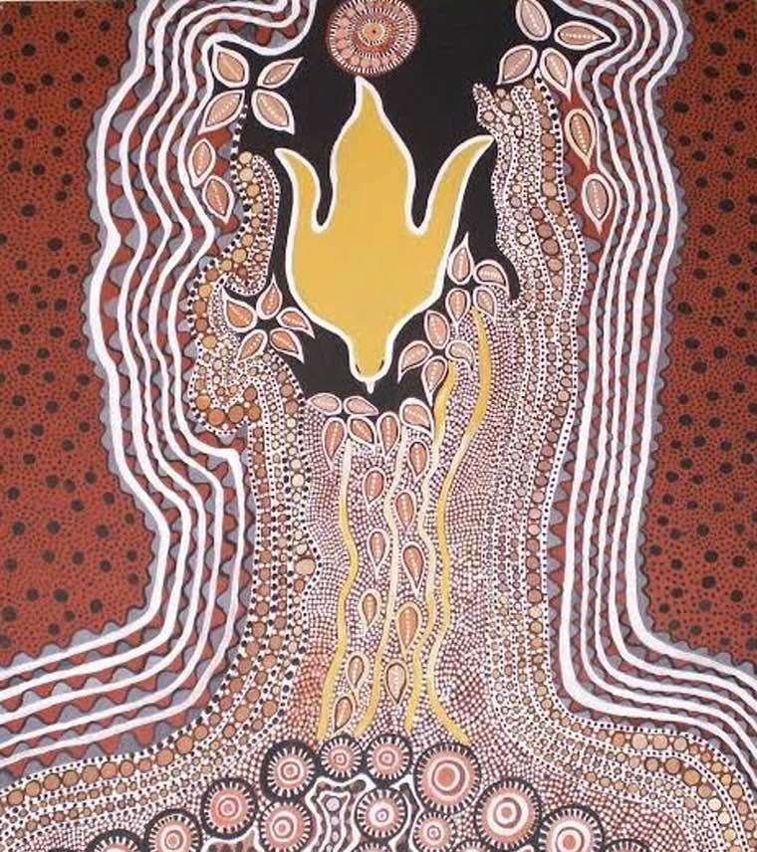
Blessing
May the grace of our Lord Jesus Christ,
who came to set us free from all sins of dividedness and domination,
And the love of God
Who created us to be with God and one another
And the communion of the Holy Spirit,
Who joins us together in truth, peace, and justice,
Be with us all, now, and forever. Amen

Slide 24
Song: May Our Lives Speak of Your Love
May our lives speak of your love
May our feet walk in your grace
May we share your friendship with all your children
Bringing hope, peace, and joy
Send us out into your world,
free to be, to live, and to love
And may all we do and say for you, bring freedom to all
Notes:
May our lives speak of your love
May our feet walk in your grace
May we share your friendship with all your children
Bringing hope, peace, and joy
Send us out into the world, free to be, to live, and to love
And may all we do and say for you, bring freedom for all

